Slide 1
Making this resource work for you
Prior to teaching this lesson, please refer to the ‘Unit Overview and Planning Document’.
Further guidance on planning Science Mastery lessons can be found in the detailed planning guidance document.
Refer to the ‘notes’ section on each slide for useful information, including suggested expositions, pedagogical content knowledge, suggested questions, answers and more. Consider using presenter mode so you can see this guidance throughout the lesson.
The introduction slides can be adapted to suit your teaching style and the needs of your class.
Before the lesson, adapt the fix-it slide to address any misconceptions identified in the previous lesson’s exit ticket.
Choose from the suggested activities to suit your class. The intention is not that you complete all of these, but that you select those which ones are most appropriate for your students. It may be appropriate to further adapt activities for your students.
These lessons are designed to occupy approximately 1 hour. To adapt for a shorter or longer lesson duration we advise you to adapt the activity section accordingly.
Please consider using the final slide to send feedback about this lesson or examples of PowerPoints that you have adapted to our design team. Your feedback is used to improve Science Mastery for all of our teachers and students. We appreciate all suggestions and comments.
Thank you for reading!
The Science Mastery Team

Slide 2

Prior Knowledge Review
Answer the following questions:
State the definition of a force.
2. State the SI unit for force.
Explain the difference between contact and non-contact forces.
Explain the difference between balanced and unbalanced forces.
State the definition of speed.
A push, pull or twist that can change the shape, speed or direction of an object.
Newtons (N).
Contact forces need objects to be physically touching in order to act, non-contact forces act over a distance.
Balanced forces are equal in size and opposite in direction, whereas unbalanced forces are not. Balanced forces do not cause a change in motion whereas unbalanced forces can change the shape, speed or direction of an object.
The distance covered per unit time.
Notes:
Foundation question: State two examples of forces.
Answer: Push, pull, twist, gravity, magnetism, electrostatic force, friction, thrust, weight, lift, drag.
Stretch question: Explain the difference mass and weight with the units for each.
Answer: Mass is the amount of matter contained in an object, measured in kg and weight is the force of gravity acting on a mass, measured in N.

Slide 3
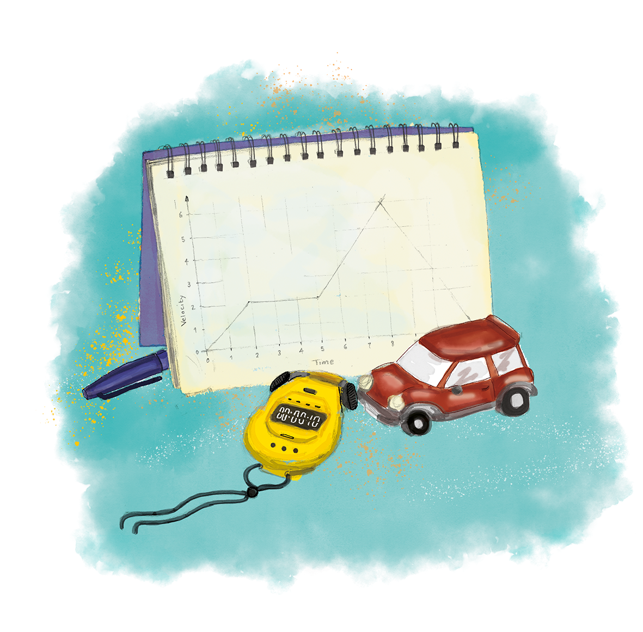
P3.1.1
13/12/2024
Prior Knowledge Review
P3.1.1 Prior Knowledge Review
P3.1.2 Scalars and Vectors
P3.1.3 Resultant Vectors
P3.1.4 Resolving Vectors
P3.1.5 Newton's Third Law
P3.1.6 Newton's First Law
P3.1.7 Acceleration
P3.1.8 Acceleration Investigation
Maths in Science Lesson 17
P3.1.9 Velocity-Time Graphs
P3.1.10 Velocity-Time Graphs 2
P3.1.11 Acceleration Problems
Notes:
Pupils should have an understanding of contact and non-contact forces, balanced and unbalanced forces and be able to explain the effects of each. They should be able to draw and interpret free-body force diagrams and be able to calculate resultant force. They will also be able to calculate speed and explain the difference between speed and acceleration. They should be able to translate a journey into a distance-time graph and be able to explain the key features.
Suggested hook:
Choose two (confident) pupils in the class and get pupils to describe how they could measure the running speed of each student to compare. You may want to also do this as a reminder of how to measure speed and the speed=distance/time equation.

Slide 4

Following this lesson, students will be able to:
Define and calculate resultant force
Interpret distance-time graphs
Describe the effects of unbalanced forces
Key Words:
force
contact
non-contact
resultant
speed
acceleration

Slide 5
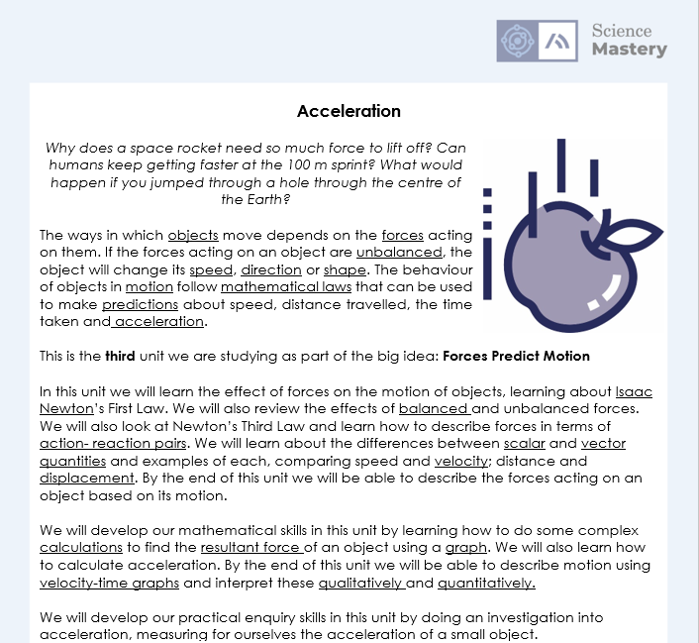
The Big Idea: Forces Predict Motion
Notes:
Purpose:. The purpose of this resource is to provide students with an overview at the beginning and end of each unit. It is designed to create a discussion about the unit prior to the sequence of lessons.
Teacher guidance:
Pupils should be directed to the P3.1 Link to Big Ideas worksheet (either in their booklet or printed).
Teachers should use guided reading techniques to read aloud with the pupils. Tier 3 vocabulary has been highlighted. (It may need to be adapted further for LPAs or pupils with different reading ages.)
Questions on the student sheet:
1. What are you most excited to learn about in this topic?
2. What do you already know about this topic?
3. Why do you think it’s important to learn that forces predict motion?
4. What knowledge from previous science lessons might help us?
5. What questions do you have about this topic?
There are a range of ways to use this resource:
1. Display on a slide for students to read as a class. Direct students to complete the activities in their book.
2. Print off for students to stick into their book at the beginning of the unit along with their knowledge organiser. Complete as a guided reading task together. Direct students to complete the activities.
3. Have students complete as part of a booklet.
Set as a homework prior to a unit.
If you have any feedback about how this resource could be used/improved, please contact the science mastery team: sciencemastery@arkonline.org

Slide 6
This is the fix-it portion of the lesson
The fix-it is an opportunity to respond to gaps in knowledge, especially those identified by the previous lesson’s exit ticket.
The teacher should customise this slide as needed, to facilitate
reteach, explanation, demonstration or modelling of ideas and concepts that students have not yet grasped or have misunderstood.
practise answering specific questions or of key skills.
redrafting or improving previous work.
Notes:
Purpose: to spend time on any gaps identified in previous learning from pre unit quiz.

Slide 7
Forces and Motion Review
Draw a free-body diagram to show the following forces acting on a box that is being pulled along a table:
15 N Weight
15 N Normal force
20 N Pulling force (to the right)
10 N Friction
Calculate the resultant force in this scenario.
Notes:
Purpose: review of residual knowledge from P1.1, P1.2 and P2.1.
Suggested activity to give thinking time and then direct questioning to targeted pupils.
Pupils can draw free body or force diagrams and will be given equal credit. Free body diagram should have the forces originating from a central dot.
Arrows should point in the direction of force action and length should be representative of size.
15 N up and down should have equal length arrows.
20 N right should be the biggest arrow, 10 N left should be the smallest arrow. Arrows should be drawn with a ruler but do not have to be to scale.
Resultant force = 10 N right (resultant force must always have a direction) as the vertical forces are balanced so cancel each other out.

Slide 8
Quick Quiz:
What are the SI units of mass and weight?
State the definition of resultant force.
State 2 non-contact forces.
What is the resultant force acting on an object when the forces are balanced?
The SI unit for mass is kilograms (kg) and the SI unit for weight is Newtons (N).
The net force acting on an object (the overall effect of all the forces acting on an object).
Gravity, electrostatic force, magnetism.
Resultant force = 0 N
Notes:
Purpose: review of residual knowledge from P1.1, P1.2 and P2.1.
Suggestion – either get pupils to write answers in books or give thinking time before cold calling. If pupils are still struggling with basic recall of these concepts it may be necessary to spend more time on review before moving on to the rest of the recap.

Slide 9

Can you explain the difference between these two words?
Mass
What is the definition of each?
What are the units?
Which would change if you went to the Moon?
How can you use one to calculate the other?
Weight
Notes:
Opportunity for pupils to discuss their knowledge of these terms (from P1.2). Questions can be added or removed depending on how much structure you would like to give.
Suggested guidance:
Talk tasks can be used in a variety of ways to suit the particular needs of the students you are teaching. Through exchanging views with others, students develop their understanding of the science beyond what could be achieved individually.
Science classrooms that successfully integrate talk have the following features:
Science talk is a regular feature of lessons and is woven into classroom activities.
Students are paired or grouped strategically by the teacher to ensure productive interaction. This might take into consideration the students’ proficiency of the English language, how encouraging they might be to peers and their attainment in the topic. It’s a good idea to consider these pairings in the class seating plan.
Students are encouraged and supported to talk, but are not forced to talk.
The teacher should take on the role of a facilitator, engaging with conversations where necessary and encouraging or steering the conversation where needed.
Students are encouraged to use the language they have to express their ideas (e.g., everyday language, imperfect English, native language), but also to incorporate science specific terminology where this is more accurate or has been taught.
6. Scientifically inaccurate ideas are not dismissed by the partner or teacher; open discussion and further investigation are relied on to help students construct ideas that support them to progress in their scientific understanding.
7. Guidelines for behaviour during talk tasks are explicit and frequently reviewed. Rules for students might be:
Listen carefully to your partner
Take turns talking.
Speak one at a time, without interrupting.
Politely agree or disagree and explain why.
Politely point out if your partner has used a scientific word incorrectly, if they have explained the science incorrectly, or if there is a more accurate way to describe something.
If confused, ask questions.
Stay focused on the discussion topic.
Respond to one another.

Slide 10
Forces and Motion Review
Complete the worksheet
Answer using full sentences where necessary
Show all working
Remember to include the correct units
Notes:
Allow pupils time to complete the review worksheet before self/peer assessing using the mark scheme provided.
Alternative activity: complete the pre test and use the suggested fix-it activities to address gaps in pupil knowledge.

Slide 11
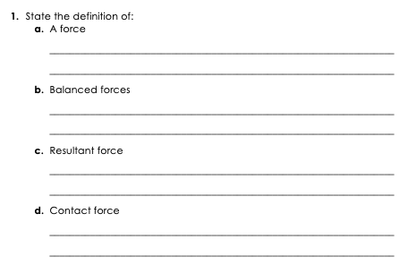
Answers
A push, pull or twist that can change the shape, speed or direction of an object.
Forces that are equal in magnitude and opposite in direction that produce a zero resultant force.
The net force acting on an object, or the overall effect of all the forces acting on an object.
Forces that act by direct contact on objects, e.g. friction.

Slide 12
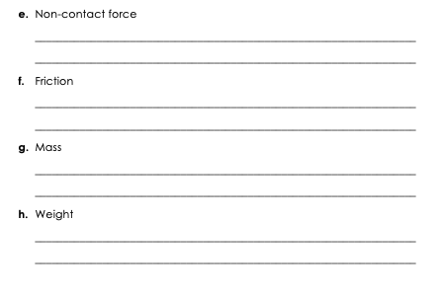
Answers
Forces that act at a distance, e.g. magnetism.
A force that opposes motion which is caused by the interaction of surfaces moving over one another.
The amount of matter contained in an object, measured in kg.
The force of gravity acting on a mass, measured in N.

Slide 13
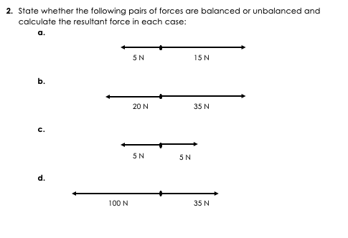
Answers
Unbalanced, Resultant force = 10 N right
Unbalanced, Resultant force = 15 N right
Balanced, Resultant force = 0 N
Unbalanced, Resultant force = 65 N left

Slide 14
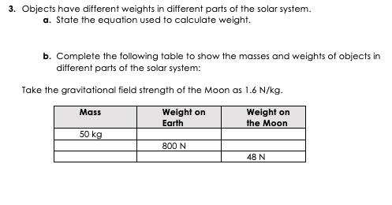
Answers
W = m x g
500 N
80 N
80 kg
128 N
30 kg
300 N

Slide 15
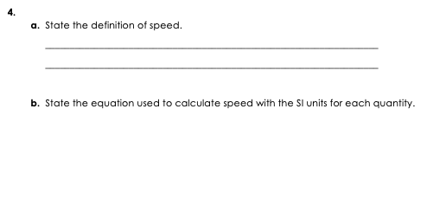
Answers
How much distance is covered in a given time.
Speed (m/s) = Distance (m)
Time (s)

Slide 16
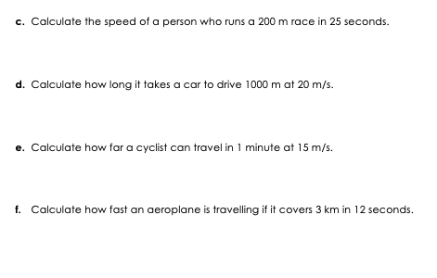
Answers
Speed = Distance
Time
Speed = 200 m
25 s
Speed = 8 m/s
Speed = Distance
Time
20 m/s = 1000 m
time
Time = 1000 m/20 m/s
Time = 50 s
Speed = Distance
Time
15 m/s = Distance
60 s
Distance = 15 m/s x 60 s
Distance = 900m
Speed = Distance
Time
Speed = 3000 m
12 s
Speed = 250 m/s

Slide 17
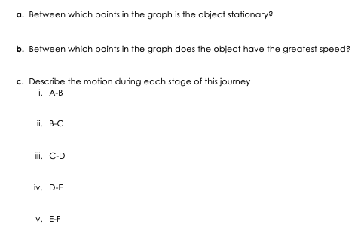
Answers
B-C and D-E
A-B (slope is the steepest)
constant speed
stationary
constant slower speed
stationary
constant speed (same speed as C-D)

Slide 18
Answer the questions below.
1. Which is the best definition of resultant force?
A. When the forces acting on an object cancel each other out
B. An interaction between two objects
C. The net force acting on an object
2. The speed of a car that travels 100 metres in 5 seconds is…
A. 20 m/s
B. 0.05 m/s
C. 500 m/s
3. A horizontal line on a distance-time graph represents…
A. An object moving at constant speed
B. An object accelerating
C. A stationary object
✓
✓
✓
Notes:
Suggested Guidance:
Q1. Answer: C
If students answer A, they have confused balanced forces and resultant forces and if students answer B, they have used the KS2 definition of a force. To fix-it, give pupils scenarios of zero and non-zero resultant forces and ask them to calculate resultant force and state whether forces are balanced or unbalanced.
Q2. Answer: A
If students answer B or C, they have not used the equation to calculate speed correctly. To fix-it, give pupils further practice of calculations of speed questions.
Q3. Answer: C
If students answer A, they have recognised the speed is not changing but not that the speed is 0 so the object cannot be moving. If students answer B, they have not understood the meaning of acceleration and may have confused speed and acceleration. To fix-it, give pupils a distance-time graph and ask them to describe the motion of the object shown. They could practice calculating speed and describing relative motion during each phase of the graph. It is crucial their understanding of distance-time graphs is secure before moving on to velocity-time graphs.

Slide 19
Lesson P3.1.1
What was good about this lesson? | What can we do to improve this lesson?
Send us your feedback by clicking this link. Thank you!

